Slide 1
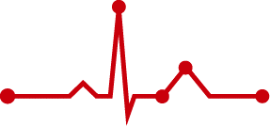
2022 추계 KHRS. Update in AI & wearable monitoring
Wearable Device in Clinical Practice
Jinhee Ahn, M.D.
Division of cardiology, Pusan National University Hospital, Busan, Korea
Notes:
2022.10.21 14:24~14:32 (8’)

Slide 2
Korean Heart Rhythm Society COI Disclosure
Jinhee Ahn
The author has no financial conflicts of interest
to disclose concerning the presentation

Slide 3
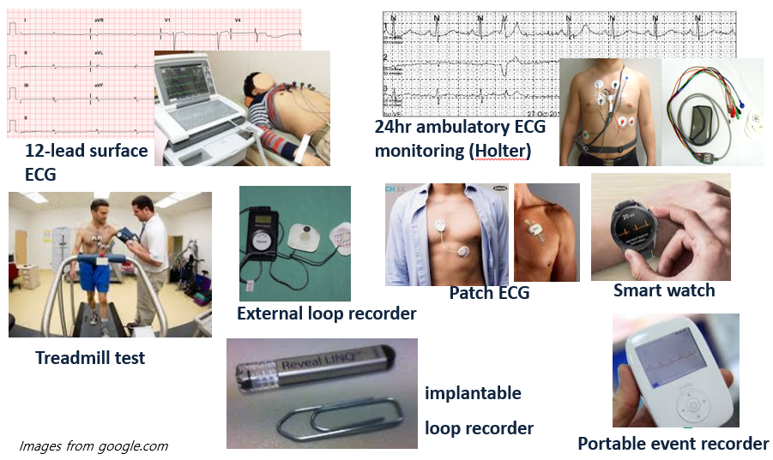
Electrocardiogram (ECG)
Symptom-related ECG documentation is mandatory to diagnose arrhythmia.

Slide 4
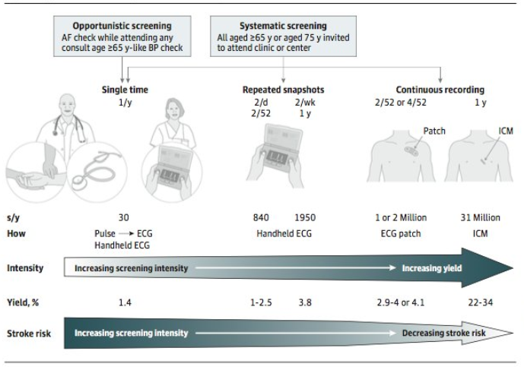
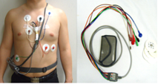
Ideal ECG monitoring
Immediate monitoring
Patient (consumer)-driven health care device
Longer monitoring → easy to use, comfortable, long battery
JAMA Cardiol 2019;4:91-92.

Slide 5
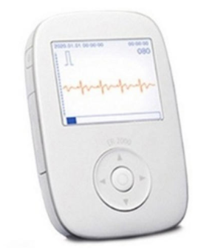
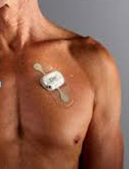
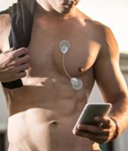
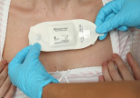
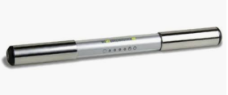
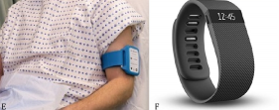
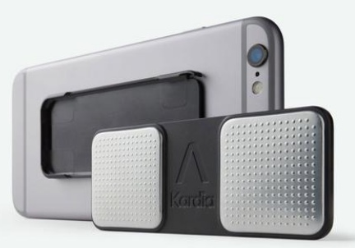
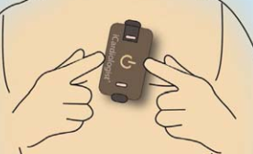
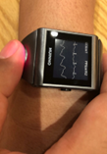
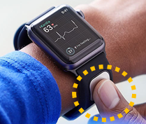
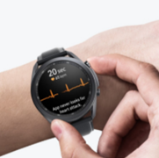
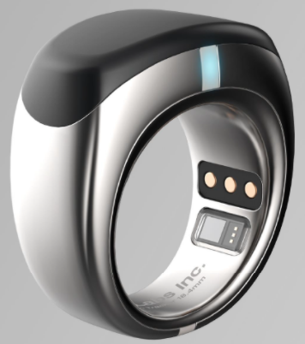
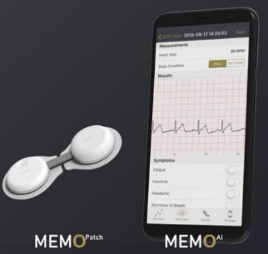
Various wearable ECG devices

Slide 6
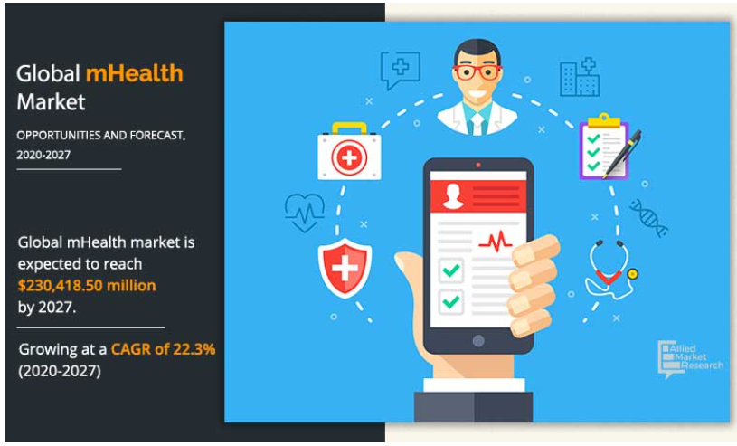
Mobile health (mHealth)
medical and public health practice supported by (wearable) mobile devices
Contributing factors for market growth
Rise in prevalence of lifestyle disorder
Development of wireless technologies
Favorable government initiatives
Affordability of smartphones
Increasing demands from
consumers/physicians
More recent attention
by COVID-19 pandemic
$46,068 million in 2019
Data from Allied market Research; Global Observatory for eHealth series Vol 3 by WHO.

Slide 7
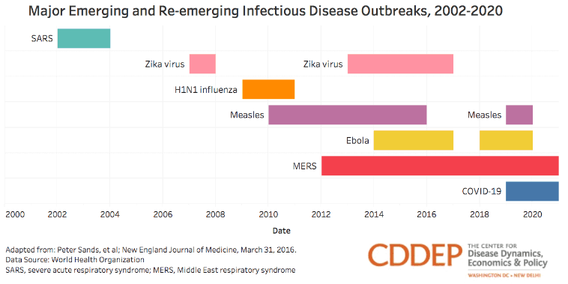
New infectious disease since 2000
Data source : World Health Organization

Slide 8
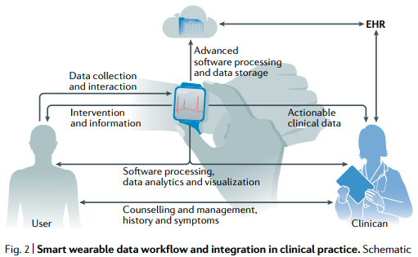
Changes in medical service
“온라인을 통한 대면 서비스”
Nat Rev Cardiol 2021;18:581-99.

Slide 9
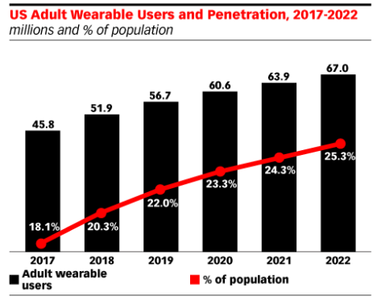
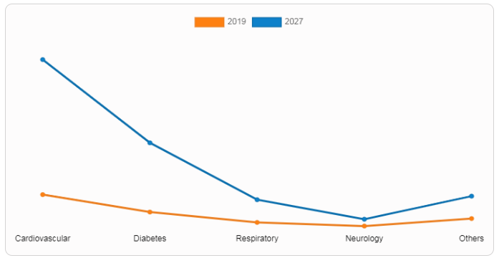
Increasing number of wearables use
[mHealth market by application]
Data from www.eMarketer.com;
Data from Global Observatory for eHealth series Vol 3 by WHO.

Slide 10
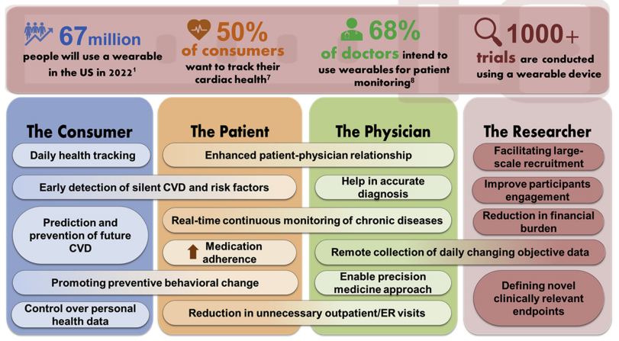
Wearable health technology in cardiovascular medicine
Heart rhythm 2020;17:889-95.

Slide 11
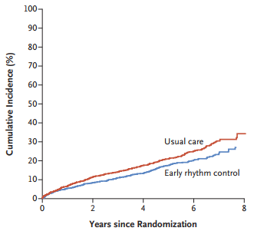
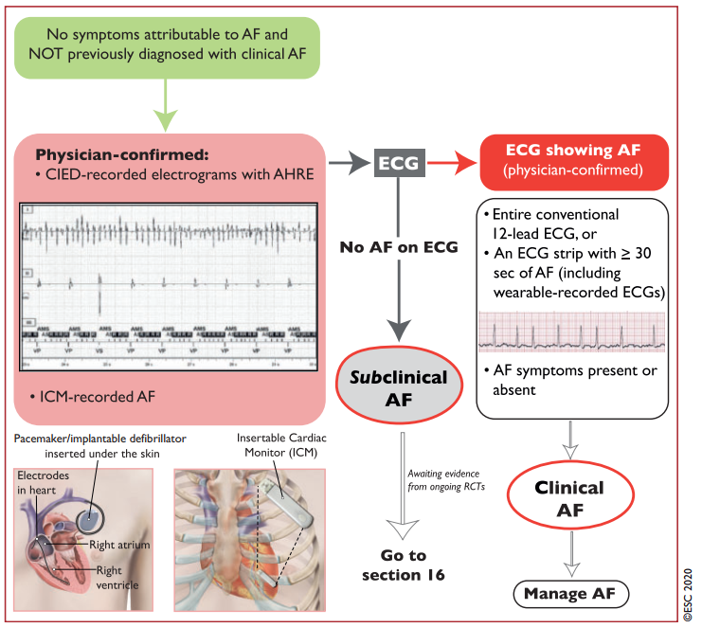
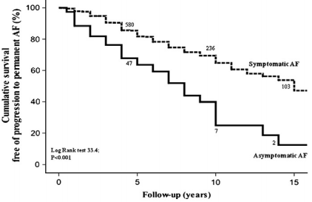
Recommendation for early diagnosis of AF
Sx (+)
“Advances in wearable technology will likely yield inexpensive and practical options for AF detection and AF burden assessment in the near future.”
Sx (-)
NEJM 2020;383:305-16; Int J Cardiol 2013;168:4744-9; 2020 ESC guideline for AF.

Slide 12
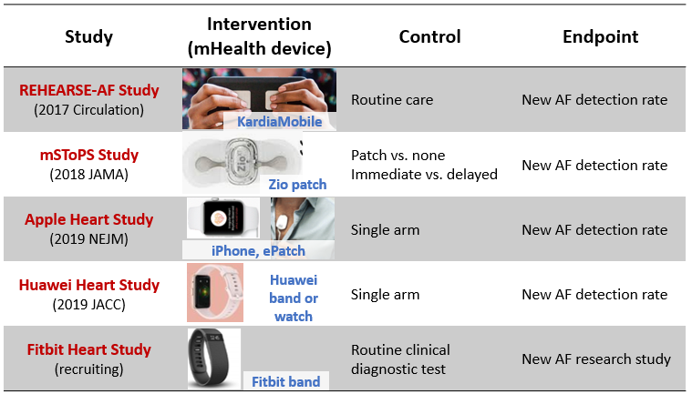
Representative clinical trials using wearable device
Circulation 2017;136:1784-94; JAMA 2018;320:146-55; NEJM 2019;381:1909-17; JACC 2019;74:2365-75.

Slide 13
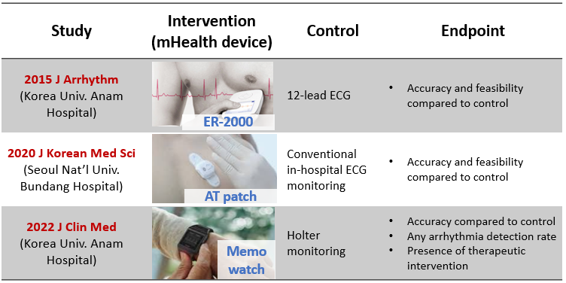
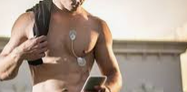
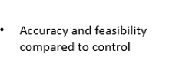
Representative clinical trials using wearable device
2021 Sensors
(Seoul Nat’l Univ. Hospital)
Holter
monitoring
Mobicare
J Arrhythm 2015;31:201-9; J Korean Med Sci 2020;35:e363; J Clin Med 2022;11:3333; 2021 Sensors 2021;21:3122.

Slide 14
Representative clinical trials using wearable device
Wearable ECG is capable of recording ECGs of good quality
Higher arrhythmia detection rate compared to conventional ECG
AF screening via ECG patches in selected high-risk individuals is feasible and clinically valuable (healthy population 0.12% vs. hospitalized patients 8%)
AF screening through PPG has shown variable accuracy depending on the algorithms and devices used.
AF screening through PPG coupled with ECG is feasible and practical; no clinical studies available; the HEARTLINE study aims to examine this application and its effect on clinical outcomes
The IPED trial showed that a single-lead ECG monitor can improve outpatient arrhythmia detection in patients who present to the emergency room with palpitations or presyncope and no clear aetiology.
Wearables can be used to assess AF burden; rhythm-guided anticoagulation is a feasible approach in some patients with AF; no clinical studies exist but a trial examining smartwatch-guided anticoagulation therapy is under development.
Nat Rev Cardiol 2021;18:581-99; Europace 2021;23:11-28.

Slide 15
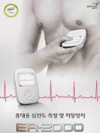
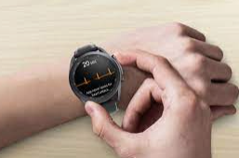
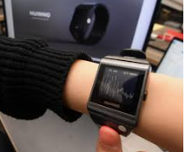
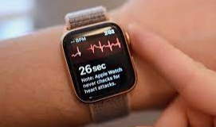
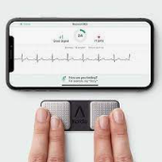
Intermittent ECG monitoring wearables in Korea
Gallaxy watch
Memo watch
ER-2000
Apple watch
Kardiamobile

Slide 16
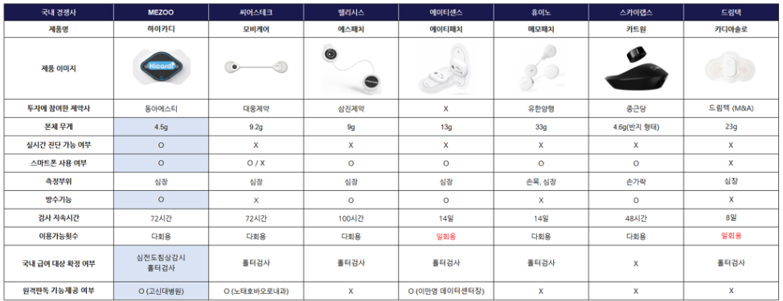
Patch-typed continuous monitoring wearables in Korea
Reusable vs. disposable
Should be connected with smartphone or not
Final analysis report service or not

Slide 17
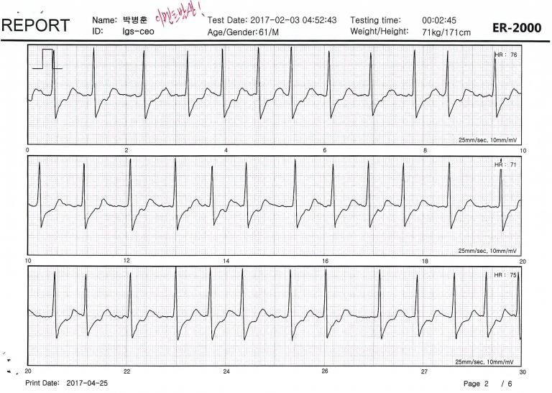
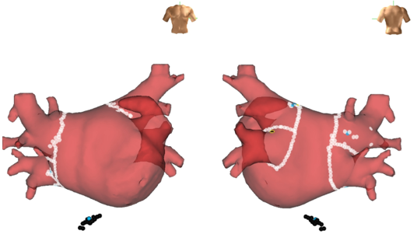
Case. M/63 with known paroxysmal AF on HCMP
→ RFCA for documented AF

Slide 18
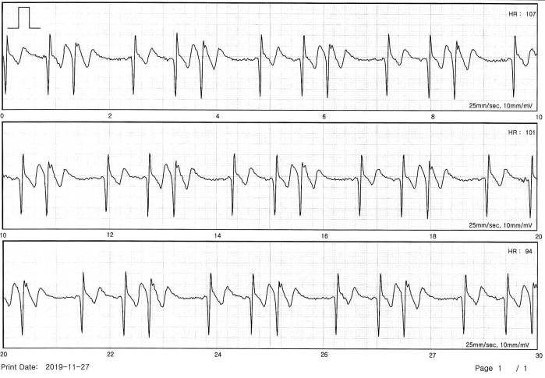
Case. M/60 with skipped beating sensation
Holter – PAC, PVC < 1%
Frequent symptomatic PACs on ER-2000®
→ Rx. Beta-blocker

Slide 19
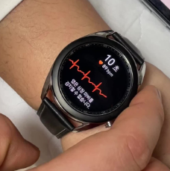
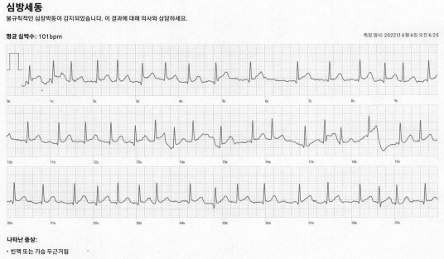
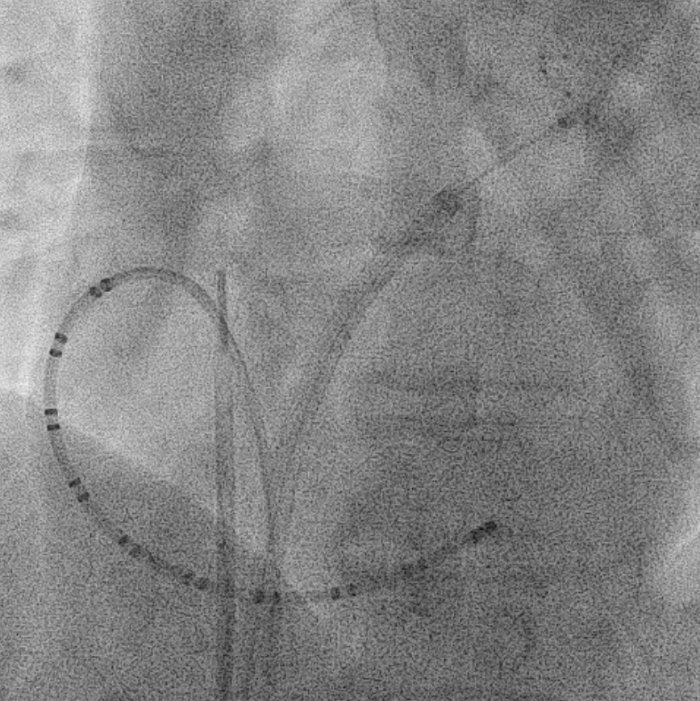
Case. M/68 on AAD with known paroxysmal AF
Intermittent chest fluttering, but normal ECG for 1 yr
→ Cryoballoon ablation

Slide 20
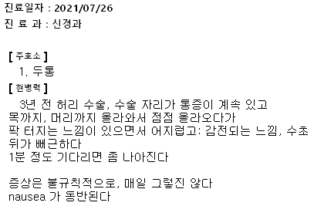
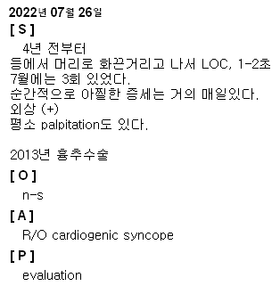
Case. M/70 with lightheadedness, recurrent syncope
→ fu loss

Slide 21
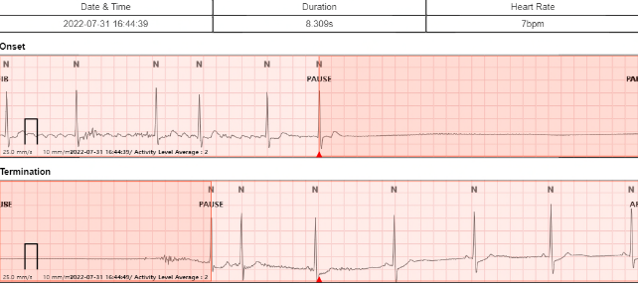
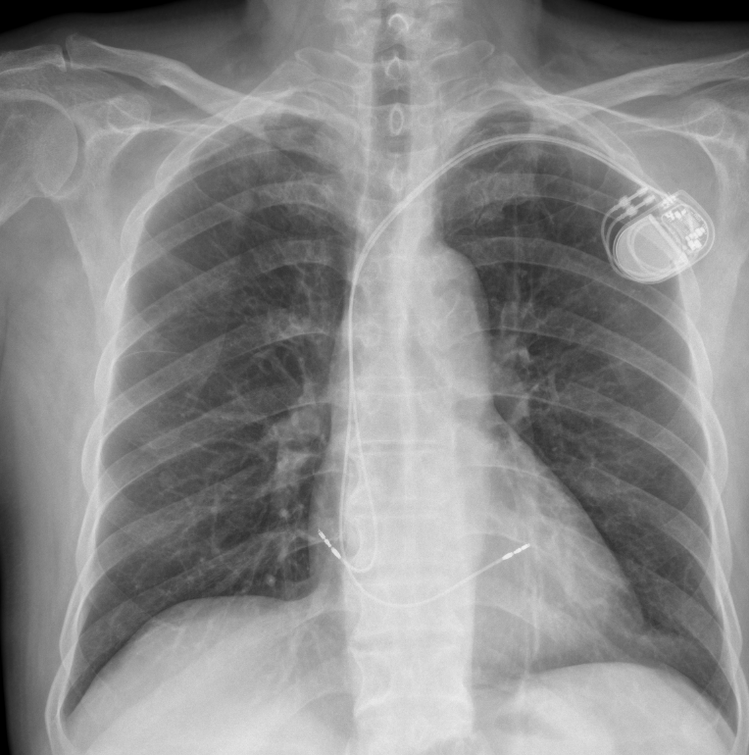
Case. M/70 with recurrent syncope
Detected 52 hrs later
Paroxysmal AF with tachy-brady syndrome
→ Pacemaker implantation

Slide 22
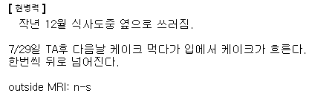
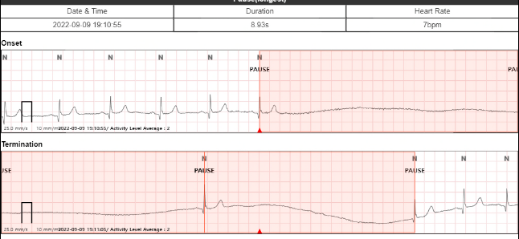
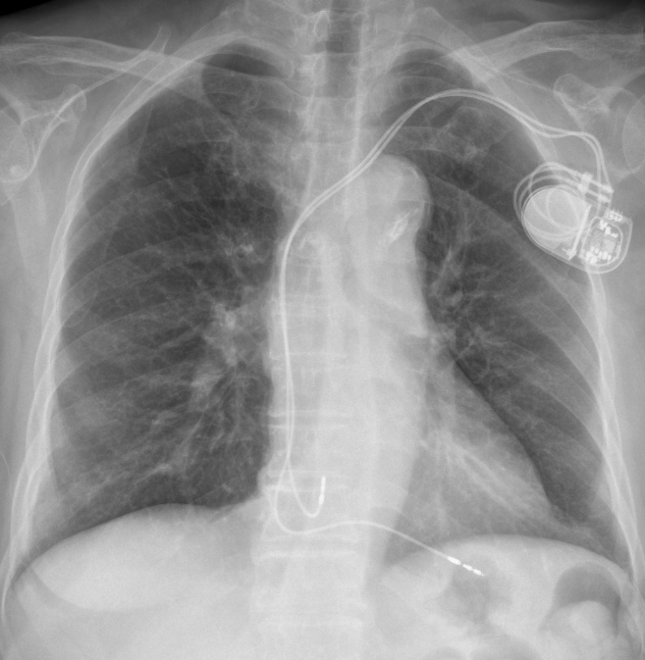
Case. F/82 with syncope
Detected 32 hrs later
Sick sinus syndrome
→ Pacemaker implantation

Slide 23
Use of patch type ECG device in PNUH
(%)
(%)

Slide 24
Is the Holter monitoring useless?
= Limitation of wearable ECG device

Slide 25
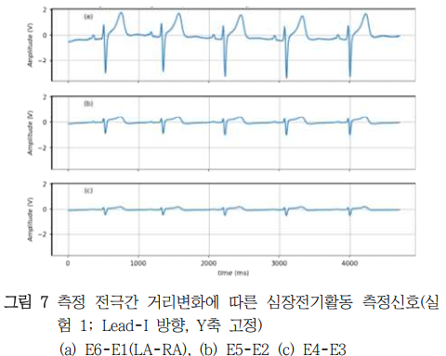
1. Short inter-electrode distance → low amplitude
Unpublished
Trans. KIEE 2018;67:1690-8.

Slide 26
2. Single lead
Rt finger
leg

Slide 27
2. Single lead
Kardiamobile
Diagnostics 2022;12:654.

Slide 28
3. Accuracy (small p wave)
Sensors 2021;21:3122.

Slide 29
3. Accuracy (artifact)
Courtesy of Dr. SY Roh

Slide 30
3. Accuracy (환자 factor)
JAMA Cardiol 2018;3:409-16.

Slide 31
4. Generalizability
Difficult use of technologies – old age, those with low health literacy or low socioeconomic population
5. Possibility of excessive anxiety or unnecessary use of medical service
6. Limited data
7. Concerns for patient privacy
Clinical prognostic impact of mHealth devices
Clin Cardiol 2020;43:1032-9; EHJ 2020,41:1075-85; J Am heart Assoc 2019;8:e010959.

Slide 32
“A clinician’s ABCD guide to wearable device use in clinical practice”
A : Assess
B : Benefit
C : Clinical workflow
D : Data
Nat Rev Cardiol 2021;18:581-99.

Slide 33
Summary
Technological innovations reach deeply into our daily lives and an emerging trend supports the use of smart wearable devices to manage health.
Previous studies demonstrated wearable ECG devices have comparable quality of ECG and higher arrhythmia detection rate compared to conventional ECG.
However, limitations of mHealth devices should be recognized.
Attempts to overcome these challenges are needed to accelerate the integration of devices into the clinical workflow for optimal patient care.

Slide 34
Thank you for your attention !

